Slide 1
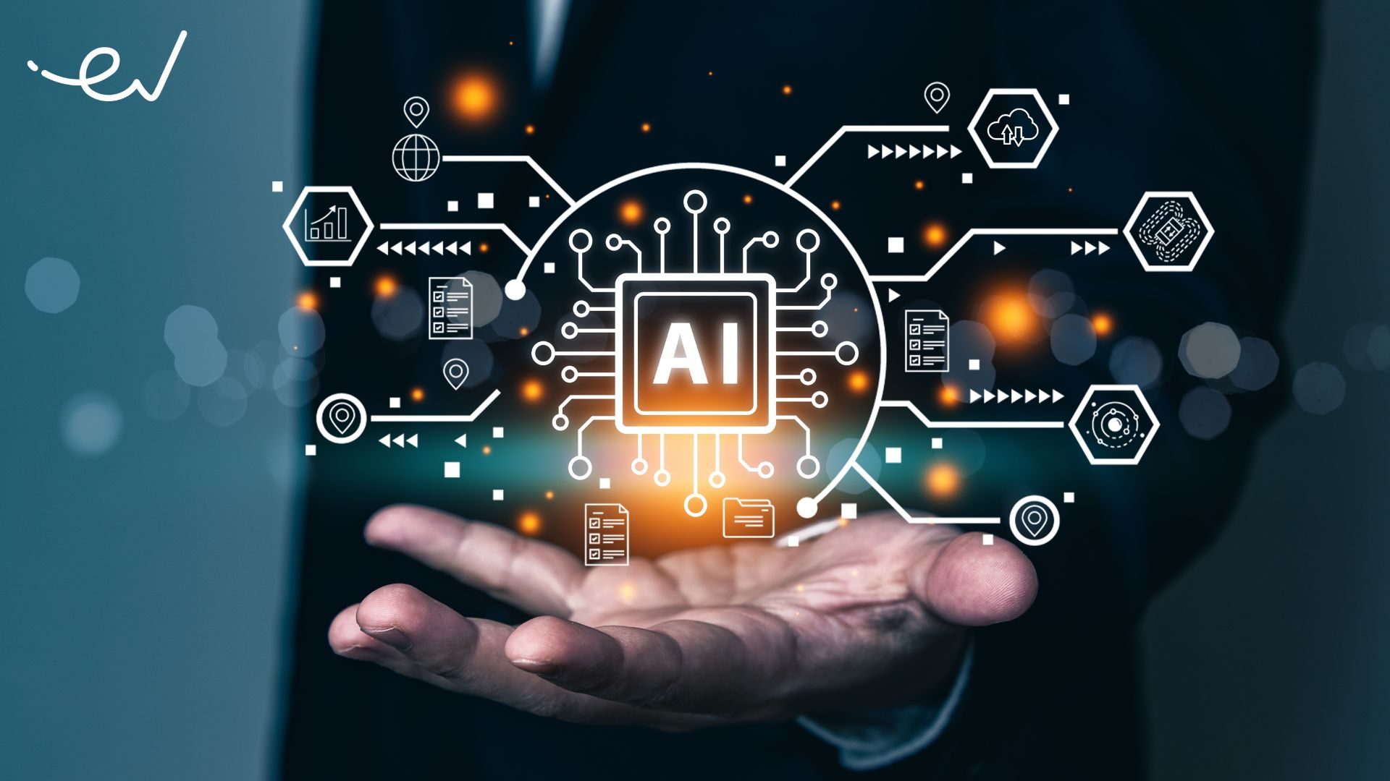

ARTIFICIAL INTELLIGENCE
(General And Popular Perspective)
Dr. Zeyad Ahmed

Slide 2
course structure
No | Description of coursework |  | Marks allocated
1 | Test |  | 20%
2 | Group Assignment |  | 40%
 | CONTRIBUTION OF THE COURSEWORK TO THE COURSE |  | 60%
 | Individual Assignment |  | 40%
 | TOTAL |  | 100%
Must pass both continuous and final assessment to pass the course

Slide 3
Learning Outcomes
Understanding AI concepts, principles and algorithms in modern computer systems.
Evaluate various AI techniques to solve real-world problems.
Build intelligent system applications using appropriate frameworks.

Slide 4
Introduction
What’s the first thing that comes to mind when you hear ‘Artificial Intelligence’?

Slide 5
Introduction
What we mean by Intelligence ?

Slide 6
Introduction
Can you name an AI tool or app you’ve used recently? How does it work?

Slide 7
Introduction
Do you think AI is more helpful or harmful to society? Why?

Slide 8
Introduction
What’s the difference between AI and a regular computer program?

Slide 9
Introduction
If you could build an AI to solve one world problem, what would it do?

Slide 10
What is Artificial Intelligence
Artificial Intelligence (AI) refers to the simulation of human intelligence in machines that are programmed to think, learn, and perform tasks that typically require human intelligence.
AI is branch of computer science focused on automating intelligent behavior in machines.

Slide 11
What is Intelligence
Intelligence is a person's ability to understand, learn, and think logically, rather than relying solely on instinct or automatic responses.
Thinking is the mental process of using one’s brain to analyze a problem, generate ideas, or form judgments.

Slide 12
Examples
Google Translate converting one language to another.
Self-driving cars detecting pedestrians.
Chatbots answering customer questions.

Slide 13
Categories of AI
Narrow AI (Weak AI)
Definition: AI designed to perform a specific task.
It doesn’t possess human-level intelligence; it only excels in its narrow domain.
Examples:
  Siri, Alexa (voice assistants).
  Netflix recommendations.
  Spam filters in Gmail.
👉 Key Point: Narrow AI is everywhere today. Almost all current AI systems belong to this category.

Slide 14
Categories of AI
Broad AI (Applied AI / Domain-specific AI)
Definition: AI that can work across multiple related domains, more flexible than narrow AI, but still not fully human-like.
It combines different narrow AI systems to handle broader tasks.
Examples:
  Healthcare AI that can diagnose several diseases, not just one.
  An AI in autonomous vehicles that can drive, navigate, and avoid accidents.
👉 Key Point: Broad AI shows progress toward versatility but remains limited compared to humans.

Slide 15
Categories of AI
General AI (Strong AI / Human-level AI)
Definition: AI that can understand, learn, and apply knowledge across any domain like a human being.
It can reason, plan, solve problems, and even have creativity.
Examples:
  Currently, General AI does not exist.
  Movies often show it (e.g., Jarvis in Iron Man, Her, Ex Machina).
👉 Key Point: General AI is the long-term vision of AI research.

Slide 16
Categories of AI
Comparison Table
Feature | Narrow AI | Broad AI | General AI
Scope | Single task | Multiple related tasks | Any task like a human
Current Status | Exists today | Emerging | Still theoretical
Examples | Chatbots, Spam filter | Healthcare AI, Self-driving cars | Sci-fi robots, Jarvis

Slide 17
Goals of Studying AI
Learn AI Basics – Understand machine learning, neural networks, and data science.
Build Smart Systems – Create AI for automation, robotics, and decision-making.
Solve Real Problems – Apply AI in healthcare, finance, and cybersecurity.
Improve Human-AI Interaction – Develop chatbots, voice assistants, and emotion-aware AI.

Slide 18
Goals of Studying AI
5. Ensure Ethical AI – Prevent bias, ensure fairness, and protect privacy.
6. Drive Innovation – Research advanced AI (AGI, quantum AI, generative AI).
7. Boost Career – Prepare for high-demand AI jobs and tech advancements.

Slide 19
Branches of AI
Machine Learning (ML):
  Trains algorithms on data to learn without explicit instructions.
  Includes supervised learning, unsupervised learning, and reinforcement learning.
Deep Learning:
  A type of ML using neural networks with multiple layers for complex pattern recognition.
Natural Language Processing (NLP):
  Enables computers to understand, interpret, and generate human language.
  Includes text analytics and language generation.

Slide 20
Branches of AI
Computer Vision:
  Allows computers to "see" and understand images.
  Used in object detection, facial recognition, and medical imaging analysis.
Robotics and Autonomous Systems:
  Combines perception, planning, and control for physical interaction.

Slide 21
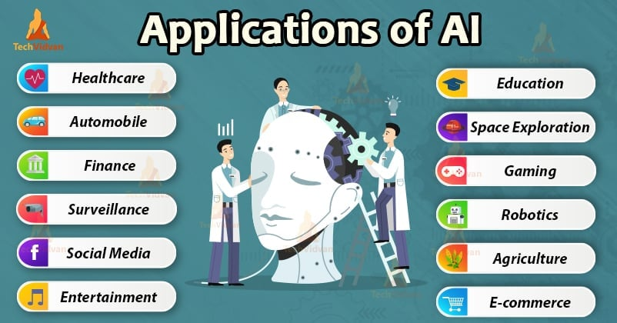
Applications of AI in the Real World

Slide 22
Applications of AI in the Real World
Artificial intelligence is being applied across a vast array of sectors and in everyday life:
Healthcare: AI assists in diagnosing diseases (e.g., diabetic retinopathy), analyzing medical images, drug discovery, and personalized treatment plans.
Finance: AI is used for fraud detection by identifying unusual patterns in transactions, algorithmic trading, credit scoring, and personalized financial advice.
Industry (Manufacturing & Supply Chains): Applications include predictive maintenance to anticipate equipment failure, optimizing logistics and supply chain routes, quality control, and automation of manufacturing processes.

Slide 23
Applications of AI in the Real World
Retail and E-commerce: AI powers customer service chatbots, provides personalized product recommendations, optimizes inventory management, and enhances fraud prevention.
Warehouses and Logistics: Self-driving vehicles and intelligent robots are used for efficient sorting, movement, and management of goods.
Daily Life: AI is embedded in smartphones (voice assistants, facial recognition), recommendation systems (streaming services, online shopping), smart home devices, and spam filters.
Other Sectors: AI is also applied in areas like education (intelligent tutoring systems), agriculture (precision farming), transportation (autonomous vehicles), and security (surveillance and threat detection).

Slide 24
Challenges and Future Trends in Applied AI
Current Challenges:
  Ensuring the reliability and robustness of AI systems.
  Dealing with the complexity of integration into existing systems.
  The need for skilled talent to develop, deploy, and maintain AI solutions.
Emerging Trends:
  Federated Learning: For privacy-preserving model training using decentralized data.
  Edge AI: Enabling on-device processing and real-time responses.
  AutoML and No-Code AI: Increasing accessibility to AI development for a wider range of users.
  Multimodal AI: Systems capable of processing and understanding multiple types of data simultaneously (e.g., text, images, audio)

Slide 25
Expert Systems
Expert Systems Designed to solve complex problems that typically require human intelligence.
Three Components:
  Knowledge Base: Stores facts and rules.
  Inference Engine: Applies rules to derive conclusions.
  User Interface: Connects user and system.
  Example :
  Medical diagnosis tools

Slide 26
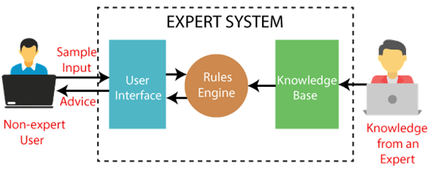
Expert Systems

Slide 27
Artificial Intelligence is not here to replace humans, but to assist and augment what we can do. The real question is: how can we use AI responsibly?

Slide 28


